Slide 1

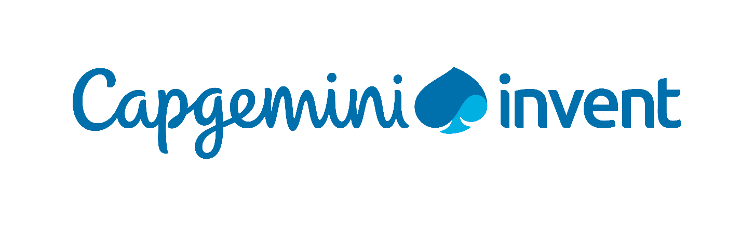
Strategic research group
Data Monetization: Proposal Response

Slide 2


Objective and scope
BACKGROUND & OBJECTIVE
Conduct market scan on current data monetization landscape and related ecosystem for a telecom industry player, BICS
RESEARCH SCOPE
Geography: Global
Market analysis covering best practices related to data monetization
Competitor analysis specific to data monetization strategy of peers (depth and breadth of information related to data monetization might vary from company to company, based on data availability through desk research)
Case examples from peer telecom players (mainly CSPs)
Benchmarks from comparable industry companies – a maximum of 5 peers– Mainly qualitative parameters* like GDPR compliance, EDGE monetization, Cloud deployment, Digital maturity etc. (getting quantitative KPIs/benchmarks from secondary sources might be difficult)
OUTPUT FORMAT
Power Point Presentation
PROJECT DEPENDENCIES & OUT OF SCOPE AREAS
We will conduct this study based on secondary research only (databases, websites, industry journals and reports, internal publications, etc.)
Company specific data is subject to availability in secondary sources
Providing quantitative benchmark values might not be possible as very few players publish data monetization related quantitative KPIs
The pricing and effort estimates are limited to efforts and methodology outlined in this document
Out of Scope:
All forms of primary research such as interviews (face-to-face or telephonic), surveys, etc.
Interviews with internal and external stakeholders
Internal analysis of BICS’ product and core capabilities

Slide 3

Our capabilities and credentials

Slide 4

We are a specialized team equipped to deliver research solutions across sectors and functional areas
200+
Member strong
delivery team
6+ years
of average relevant
work experience
SECTOR SPECIALISTS
Financial Services
Manufacturing, Auto & Life Sciences
Telecom Media and Technology
Consumer Products, Retail & Distribution
Energy, Utilities & Chemicals
Public Services
Specialists across a
majority of
INDUSTRIES &
FUNCTIONS
Exposure to working with clients in more than
20+ Countries
FUNCTIONAL AREA EXPERTS
Consumer Behaviour
Technology
Operations / Processes
Digital Customer Experience
Financial Benchmarking
Social Media
Note: Specialists here refer to research specialists

Slide 5
We use multiple research techniques & several enablers to cater to research needs & decision making across all business aspects
CLIENT RESEARCH NEEDS
VALUE-DRIVEN INSIGHTS
RESEARCH ON CORPORATE STRATEGY
Identify right industry trends and technologies
Industry trends and innovations
Regulatory scanning
Scenario Planning
Business risk assessment
Regularly study markets to generate
periodic insights
TECHNIQUES
Create detailed playbooks for account intelligence
RESEARCH ON MARKETS
Research design
Data collection
and analysis
Visualization
Market sizing and growth
Market characteristics and dynamics
Market and competitor intelligence
Analyze consumer behaviour
Survey solution
Hypothesis driven insights generation
Create the right brand strategy
RESEARCH ON CONSUMERS
Construct a social media strategy
Usage & attitude
Customer satisfaction
Shopper research
Global panel procurement
Blend of SMEs
& Generalists
Proprietary frameworks
Identify operational and business position as compared to peers
RESEARCH ON PRODUCTS/BRANDS
World-class platforms
Comprehensive database repository
ENABLERS
Establish leading practices for processes and functions
New product launch
Concept testing
Product testing
Pricing research
Positioning research
Packaging testing
Brand health and equity
Benchmark and select the right vendor / supplier
Evaluate business cases and projects
RESEARCH ON SALES & OPERATIONS
Sales forecasting
Processes and sales performance benchmarking
Perform modelling and scenario planning

Slide 6
We have a structured methodology and robust processes to build high quality reports from a greenfield start state
6.
1.
REPORT BUILDING AND VISUALIZATION
Build and design the concise PDF or PPT report
Visualization of key metrices
/findings/recommendation through dashboards and infographs.
IDENTIFY THE NEEDS AND FORMULATE THE OBJECTIVES
Understand the context,
Identify the key questions to be addressed,
Understand scope, coverage and timelines
DRAW KEY INSIGHTS AND RECOMMENDATIONS
Build the key messages and so-what takeaways,
Draw the final recommendations
CHALK OUT THE PROJECT CHARTER
Conduct preliminary analysis
Initiate hypothesis testing
Build the project charter
Create the storyboard
5.
2.
ANALYZE THE DATA
Statistical analysis,
Key driver or Root Cause analysis
Predictive data analytics
BUILD THE RESEARCH DESIGN
Secondary research –Subscription research databases, analyst reports, industry association websites, Company annual reports/SEC filings, CXO briefings, free text search
Qualitative research- In-depth interviews, Focus group discussions, Expert/SME interviews, Observatory research
Quantitative research- Face to face surveys, telephonic surveys, online surveys
4.
3.

Slide 7
We synthesize the information into impactful industry trends, competitor intelligence, benchmarking and thought leadership reports
Market Trends and Composition
Competitor Profiling and Analysis
Market Entry Strategy
Maturity Assessment
Financial, Operational and Vendor Benchmarking
Industry Best Practices
MARKET & COMPETITION
BENCHMARKING & BEST PRACTICES
Point of Views & Blogs
Sector Trends Report
Insights Periodicals
Recurring Market Intelligence
Periodic Market Insights Reports
Newsletters on Focus Topics
THOUGHT LEADERSHIP & POVs
WATCHTOWER & MARKET INTEL.

Slide 8
Through our global panelist coverage we offer a range of survey solutions to provide valuable market insights
Research
Design
Survey
Solution
Global Sample
Procurement
Data
Analysis
BI &
Reporting
Research
Insights
Consult to understand client company, industry trends and specific business/marketing issue at hand
Design methodology and sample frame
Quantitative questionnaire & qualitative research guide design
Define analyses framework to address the key business challenges
Platform-agnostic
Online, mobile, web intercept and qual programming
Interactive survey tools
Dynamic question types
Mobile/tablet optimized
Multi-lingual/Multi-country
Real time reporting and field monitoring
Access to 110+ million panel across 70+ countries
B2B, B2C, ITDM
65+ global sample partners
Hard-to-reach audiences
Local language support
Multi-mode sampling
De-dupe & data checks, Digital fingerprinting
In-house panel recruitment
Data Management
Validation
Data normalization and transformation
Benchmarking
Analysis
Data aggregation/ Tabulation
Various descriptive, Bi variate & Multivariate statistical analysis
Diagnostic statistics
What-if analysis
Engaging dashboard
Online
Offline
Tailored portal solution for integrated data collection and reporting
Benchmarking capabilities
Simulators & scorecard
Visualization design & development
Data based insights amalgamating both qualitative and quantitative research
Insight capabilities across life cycle of a product
Insights generated from both consumer and business segments

Slide 9

We helped Nestle uncover untapped market and consumer potential
IMPORTANT QUESTIONS
SOLUTION
PREFERRED PARTNER
Since 2015
BRAND HEALTH
How strong is my brand?
Assessed awareness, usage, satisfaction, disposition, attitudes, perceptions, and user profile across user segments of Current user, Infrequent user, & Lapsers
Done research
and insights projects
covering multiple geographies
Worked across major categories
within Nestle:
  Prepared dishes & cooking aids
  Nutrition & health science
  Powdered & liquid beverages
  Petcare
  Confectionary
  Water
  Milk products & ice-cream
CONSUMER
How to improve purchase and loyalty conversion rates?
Consumption, reasons for product selection, purchase behavior, channels of purchase, influencers, for client brand versus competition.​
PRODUCT LAUNCH
Is messaging and packaging clear for my new product?
Gauge consumer sentiment and choose the right packaging design for their product
SALES &
DISTRIBUTION
STRATEGY
What Retail channels my customers are looking at?
Understanding and rating Retail service parameters, evaluated by store type (physical store versus online), Reasons for store preference etc.

Slide 10
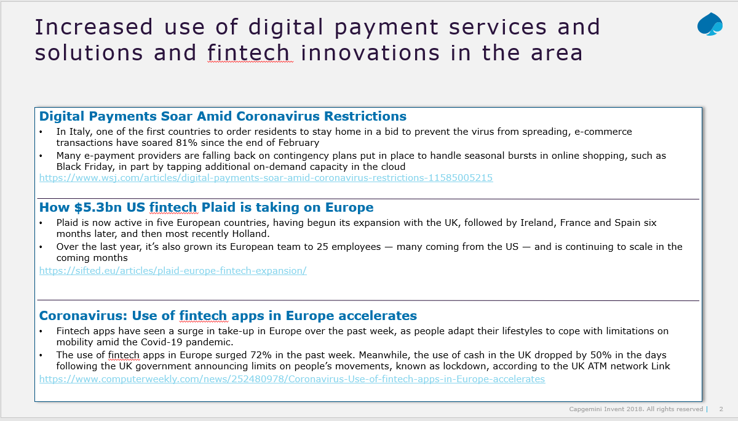
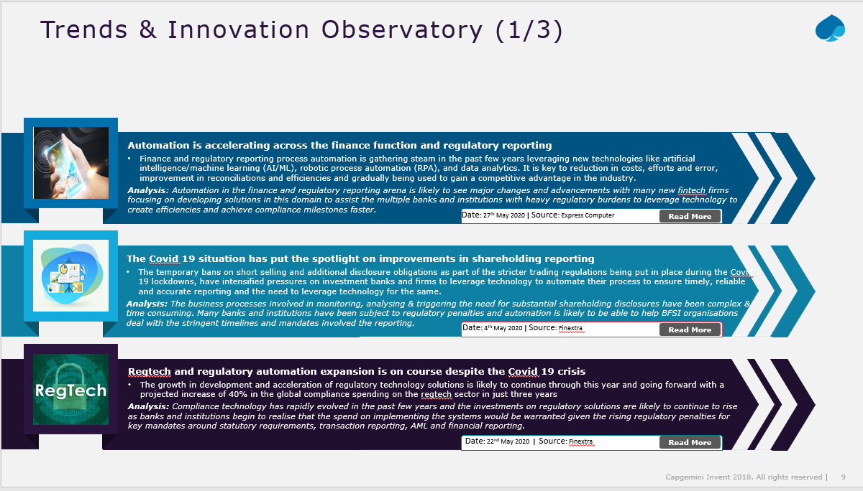
We successfully established a market observatory to track key movements in the fintech / regtech landscape with BNPP account
FS: Fintech and Regtech Watchtower
Set up a market observatory to capture recent developments in the financial markets
Worked across major categories like:
  Fintech
  Regtech
  Payments
  Other emerging technologies
  The research helped the client to understand key developments in the fintech/regtech space and capitalize on market opportunities

